Slide 1
Running the Numbers: Evaluating Team Rushing Success in Relation to Running Back and Offensive Line Spending
Devin Duran and Russ Steil

Slide 2
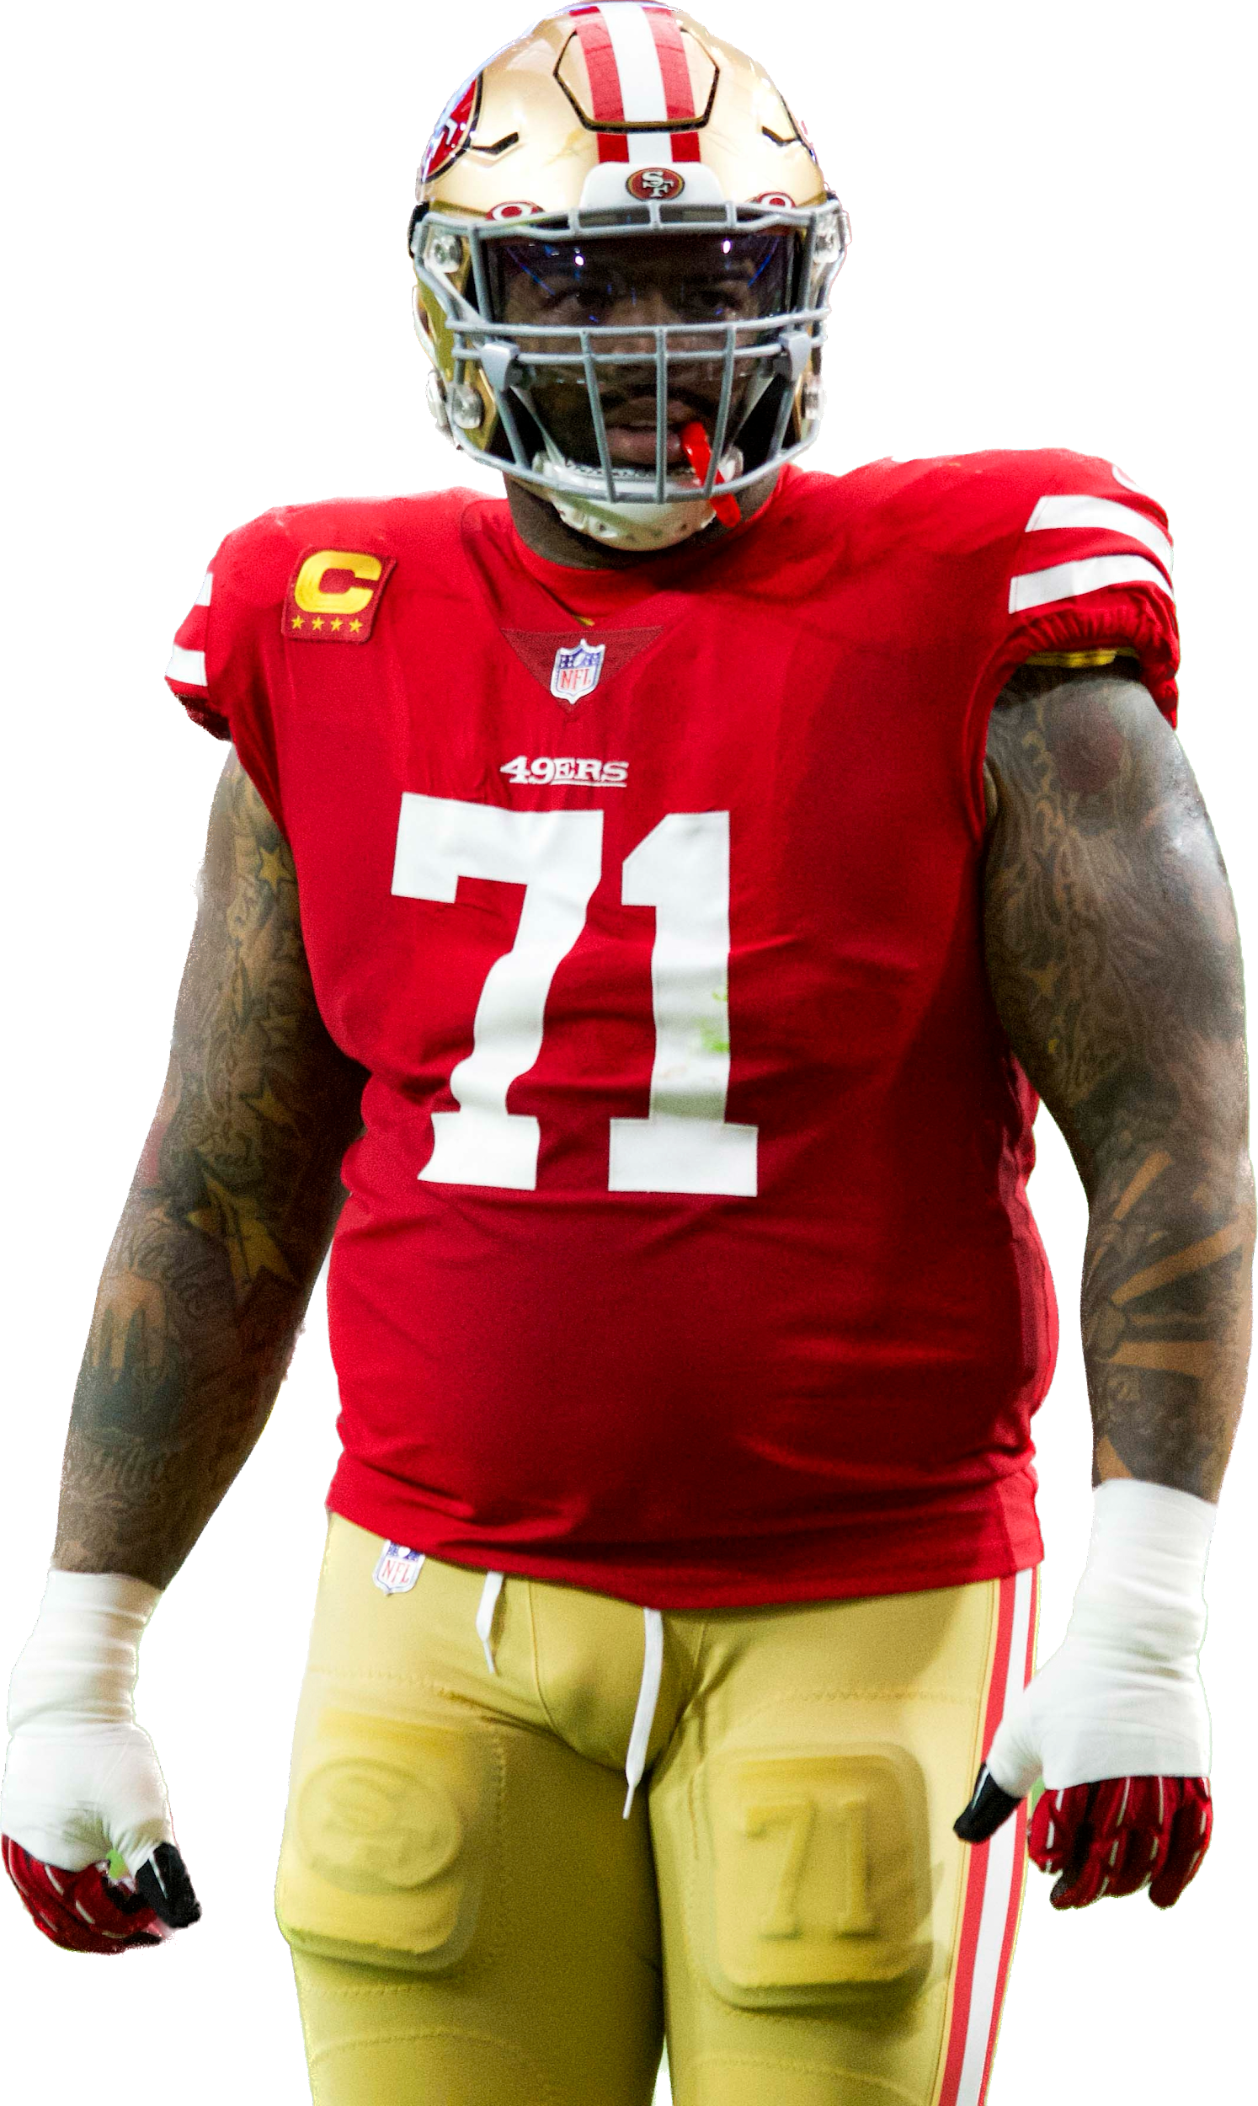
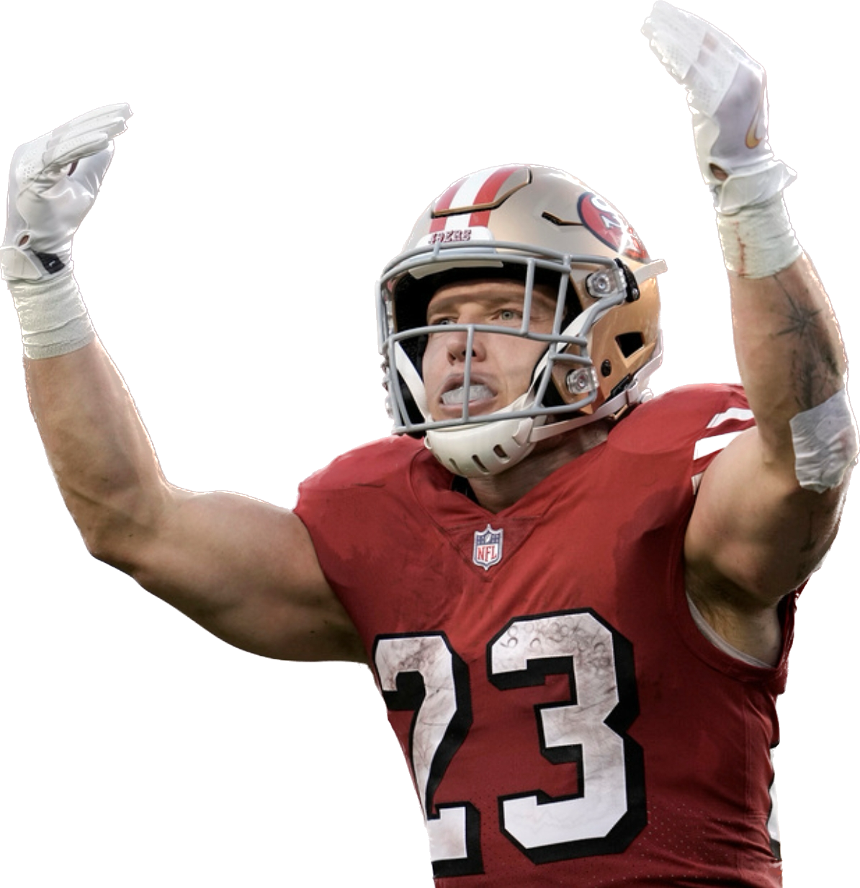
Introduction
In today’s NFL, one of the most polarizing debates is the value of running backs
Who is should get credit for a team’s rushing attack?
Running backs or offensive linemen?

Slide 3
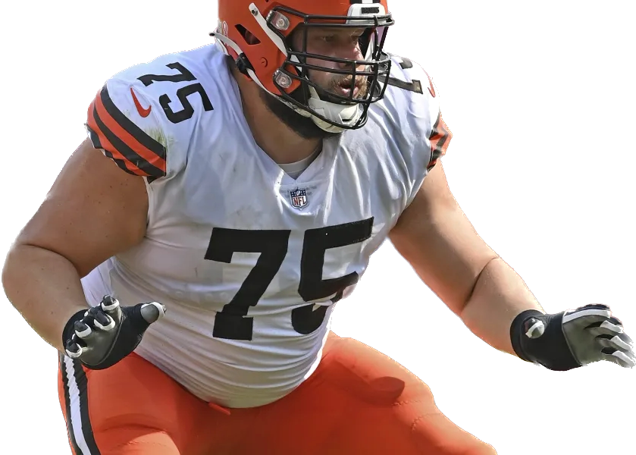
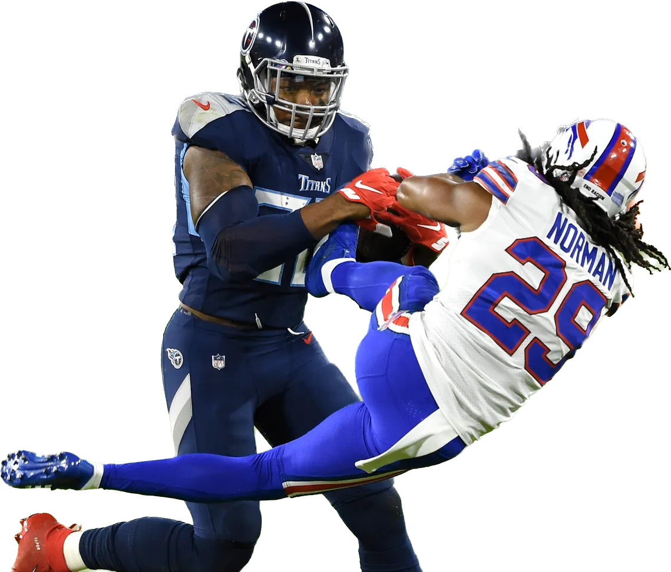
Hypotheses
The salaries of running backs has a great impact on the team’s rushing yards and touchdowns
The salaries of offensive linemen has a great impact on the team’s rushing yards and touchdowns

Slide 4
Methods
We web scraped data concerning financial and statistical data from sportstrac.com and sportskeeda.com respectively
We then ran a Shapiro-Wilk test on each of the four metrics and used a Spearman-Rank correlation test

Slide 5
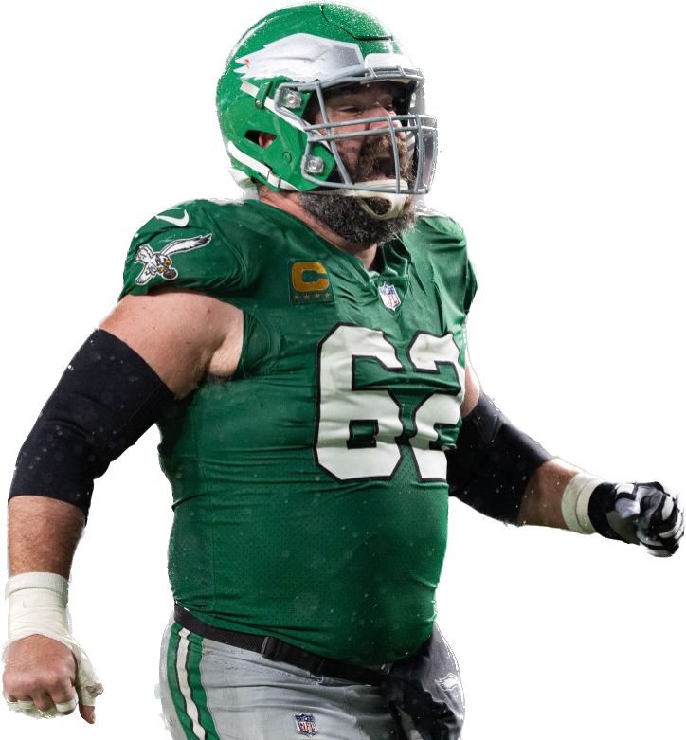
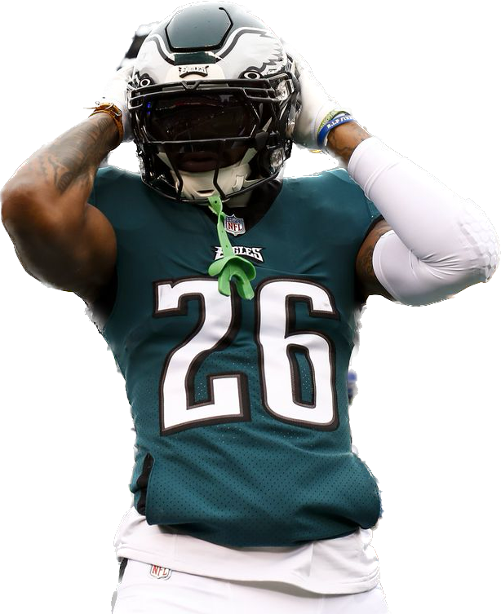
Results
We concluded that the salaries of running backs have little to no correlation with rushing yards and touchdowns
We concluded that the salaries of offensive linemen have little to no correlation with rushing yards and touchdowns

Slide 6
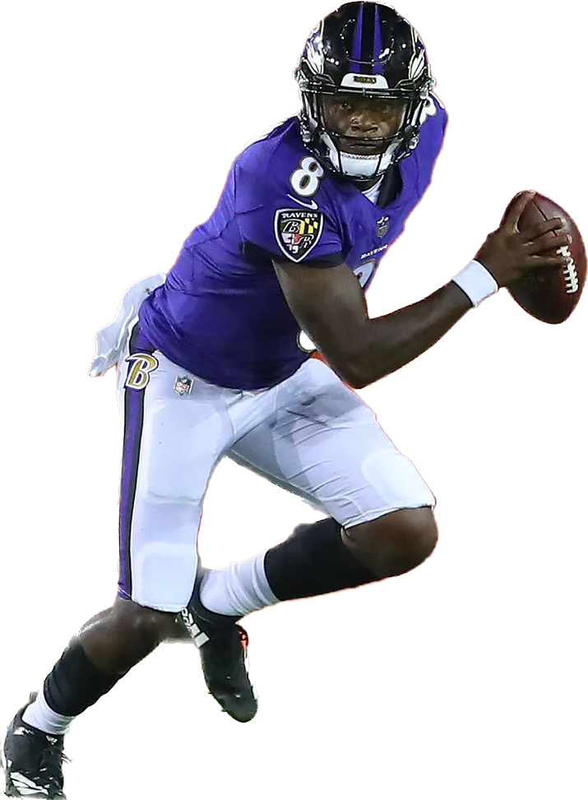
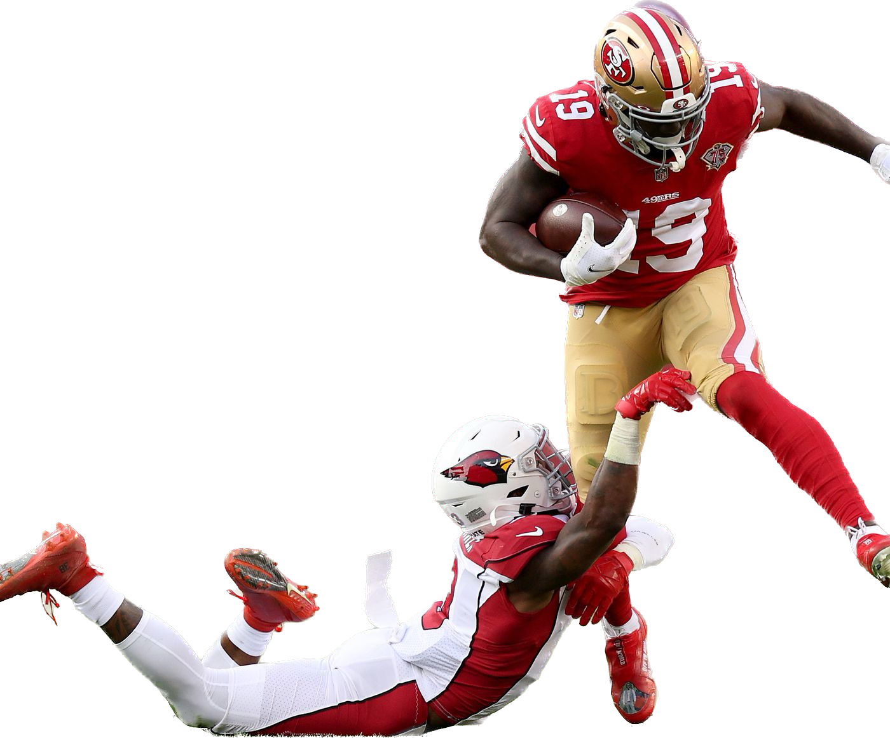
Conclusion
While running backs are the main carriers of the football, investing money in them does not make a huge difference in a team’s rushing stats
Investing big money in offensive linemen, however does correlate to a teams rushing stats as they block for every play and every player.

Slide 7
References
Brandt, A. (2023, June 21). NFL running backs face financial disadvantages ... - sports illustrated. Sports Illustrated. https://www.si.com/nfl/2023/06/21/nfl-running-backs-value-business-football
Kim, S., Sarin, A., & Sarin, S. (2018). Do players perform for pay? an empirical examination via NFL players’ compensation contracts. Journal of Banking &amp; Finance, 88, 330–346. https://doi.org/10.1016/j.jbankfin.2018.01.004
NFL running back spending - cap. Spotrac.com. (n.d.). https://www.spotrac.com/nfl/positional/running-back/
Sportskeeda. (n.d.). 2023 NFL team stat leaders - passing, rushing, scoring, defense and much more. 2023 NFL Team Stat Leaders - Passing, Rushing, Scoring, Defense and much more. https://www.sportskeeda.com/nfl/team-stat/rushing-yards-leaders
Types of football injuries. Jonathan Perkins Injury Lawyers. (2023, May 16). https://www.800perkins.com/practice-area/types-of-football-injuries/#:~:text=Players%20in%20the%20offensive%20line,to%20the%20majority%20of%20injuries.

